Slide 1

HPC Roary Cluster
Management Nodes –
Part 2 – xCAT Management

Slide 2
HPC Management Nodes
Master Nodes:
Active Master Node: HPCxCaT
Used for:
Slurm Workload Manager (Open-source Job Scheduling System)
xCAT - Extreme Cloud Administration Toolkit, open-source distributed computing management software developed by IBM
Hardware:
2 nodes x Dell R630
56CPU / 256 GB Memory
Current OS installed
same configuration on both nodes
Currently running CentOS7.8 (64bit) across the cluster
One Local Partition: / (420 GB)
Additional mounts come from the Lustre FS: /home & /scratch
Notes:
xCAT (Extreme Cloud Administration Toolkit) is open-source distributed computing management software developed by IBM

Slide 3
Role of xCAT
Role of xCAT -
Remotely Manage Systems:
Remotely manage systems via ILO/DRAC
OS provisioning: login/compute nodes (CentOS 7 x64bit) in parallel (diskful, diskless) via PXE boot
Control and maintain servers’ RPMs, configuration files in parallel via postscripts, initiate remote commands
Uses additional services for provisioning OS:
-TFTP (load OS via PXE boot)
-DNS (name resolution in the roary.net domain)
-DHCP (IP assignment with MAC)
-Maintain /etc/host file
-Local Repository in the cluster

Slide 4
xCAT Installation
Installation Guideline
xCAT:
https://xcat-docs.readthedocs.io/en/stable/
Pre-requisites:
-Make sure NTP is enabled across the cluster
https://github.com/xcat2/xcat-core/wiki/XCAT_2.13.3_Release_Notes
https://xcat-docs.readthedocs.io/en/stable/guides/install-guides/yum/manual_install.html
-Passwordless SSH for root is enabled across the cluster from ms1/ms2
-Configure a VIP network interface dedicated for the active xcatmaster
-VIP for xcatmn: 192.168.248.60 (em3:0) only up on active master node (ms1)
-Host IP for ms1: 192.168.248.61 (em3) | ms2: 192.168.248.62 (em3)
-ms1/ms2 configured as ntp, nameservers on xcat
-xcatmn used as dhcp server, dns server, tfpserver in mgmt network
-roary.net domain used

Slide 5
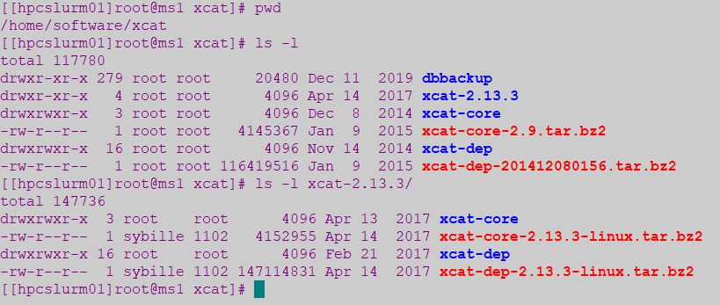
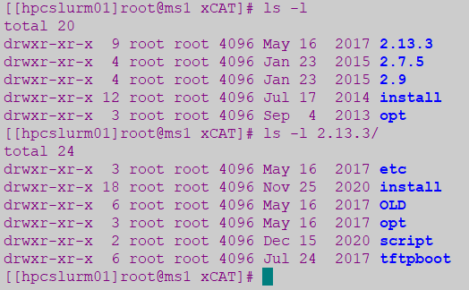
xCAT Installation
xCAT Installed under Lustre FS:
Tar downloaded under /home/software/xcat/
On active master node mount these xcat partitions from lustre
Installation launched from Xcat-core / xcat-dep repositories
Installation prefix path: /home/share/xCAT/2.13.3

Slide 6
xCAT stop/start scripts
xCAT stop/start scripts:
Manually stop/start xCAT on master node (ms1/ms2)
xCAT script to stop/start xCAT daemons located under /bin/
-stop-xcatmn > /home/share/xCAT/2.13.3/script/stop-xcatmn
This will stop/start xCAT daemons, dhcp, unmount lustre, stop/start VIP NIC interface em3:0
xCAT daemon is xcatd
-start-xcatmn > /home/share/xCAT/2.13.3/script/start-xcatmn

Slide 7
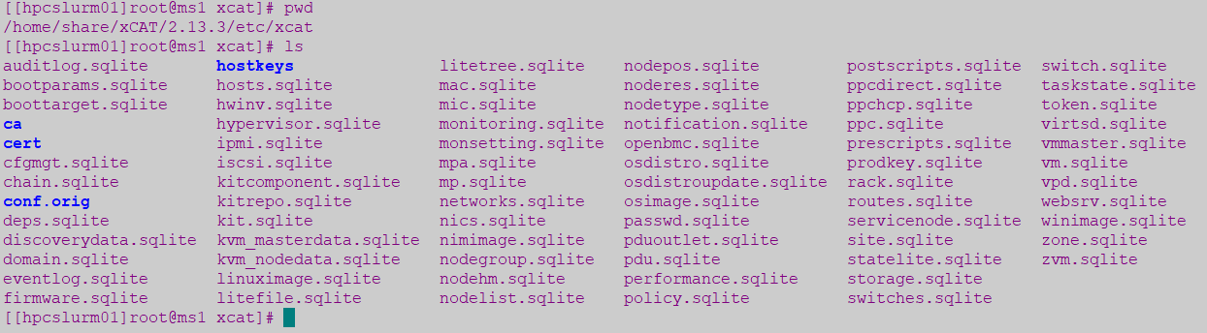
xCAT Configuration
xCAT Configuration Files:
Lustre Location: /home/share/xCAT/2.13.3/etc/xcat
xCAT configurations are stored in multiple tables on the SQLite DB – located under /etc/xcat (mount from lustre)

Slide 8
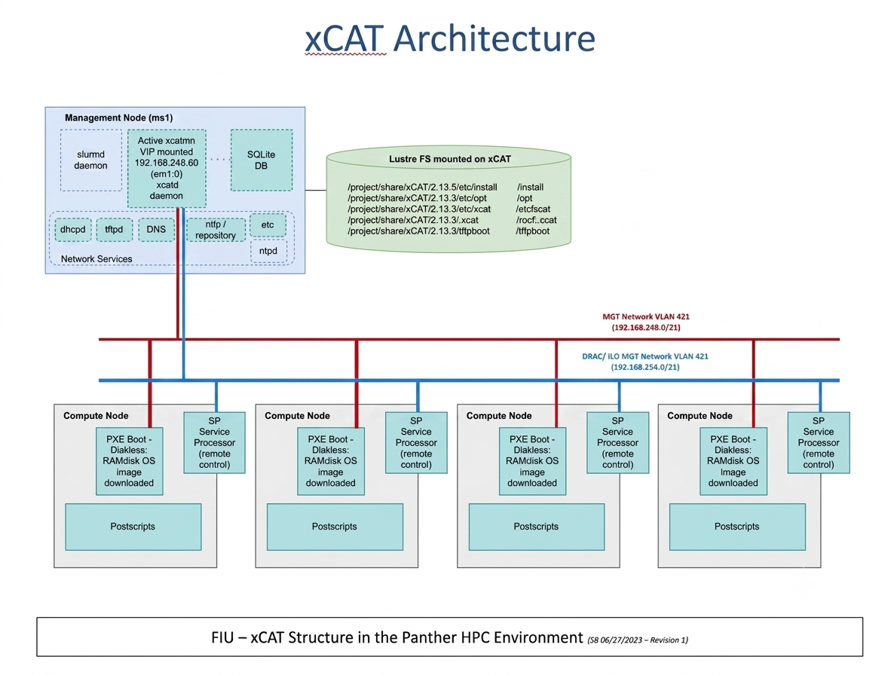
xCAT Architecture
FIU –xCAT Structure in the Roary HPC Environment (06/03/2026- Revision 2)

Slide 9
xCAT – Basic Concepts
xCAT Basic Concepts:
xCAT Objects (has 20 Types): most important are node, group, osimage objects
Global Configuration: some configuration must be set before starting using xCAT on the site, policy, passwd and networks table
xCAT Network: requires understanding of the network in order to be able to centrally managed the servers remotely
xCAT Database: All data for the xCAT Objects and global configuration are stored in xCAT Database
Notes:
https://xcat-docs.readthedocs.io/en/latest/guides/admin-guides/basic_concepts/xcat_db/index.html
https://xcat-docs.readthedocs.io/en/latest/guides/admin-guides/basic_concepts/xcat_object/index.html

Slide 10
xCAT – Manipulate DB Tables/Objects
Manipulate
xCAT DB Tables:
tabdump: Display headers and all rows of table in CSV format
tabedit: Open table in edit mode in flat CSV format and save changes with :wq (like vi)
tabgrep: List table names in which an entry for the given node appears
Sample: tabdump site | tabedit site | tabgrep n055 | chtab node=node1 nodelist.groups=all
chtab: Add/delete/update rows in the database tables
Manipulate
xCAT Oject Definitions:
lsdef: List data object definitions
mkdef | chdef | rmdef: Create/Change/Remove data object definitions
nodels: List node group, list the nodes and their attributes
nodeadd | nodech | noderm: Add/Change/Remove node attributes from DB
Sample: nodech node1-node4 groups=all | chdef -t node -o node01 groups="all"
Helpful Commands:
man tablename: Get detail info on columns and table definitions (or use tabdump -d tablename)
man xcatdb: Complete reference
Sample: man object_type | table_name | man mkdef
Notes:
https://sourceforge.net/p/xcat/wiki/Listing_and_Modifying_the_Database/#node-group-support-in-the-xcat-tables
https://xcat-docs.readthedocs.io/en/latest/guides/admin-guides/references/man7/group.7.html

Slide 11
xCAT - Global Configuration
Global Configuration:
site: Global settings for entire cluster (tabdump site)
policy: Controls who has authority to run specific xCAT operations (ACL)
passwd: Contains default userids and passwords for xCAT to access cluster components used during config/install and for SP (bmc)
networks: Contains the network definitions in the cluster

Slide 12
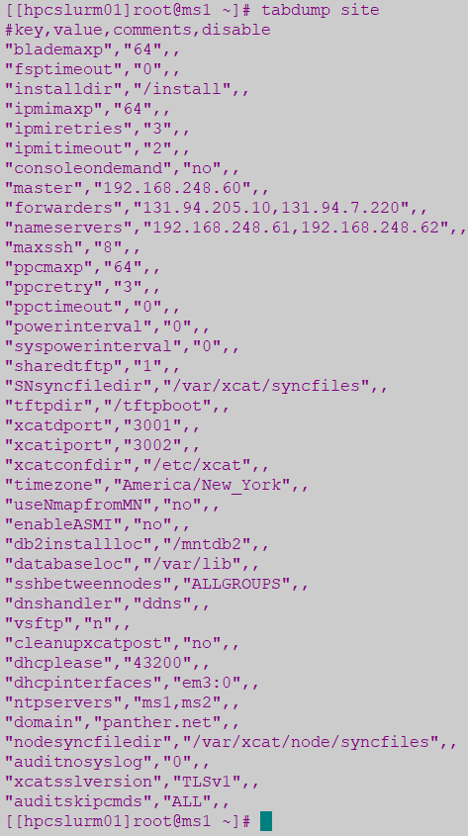
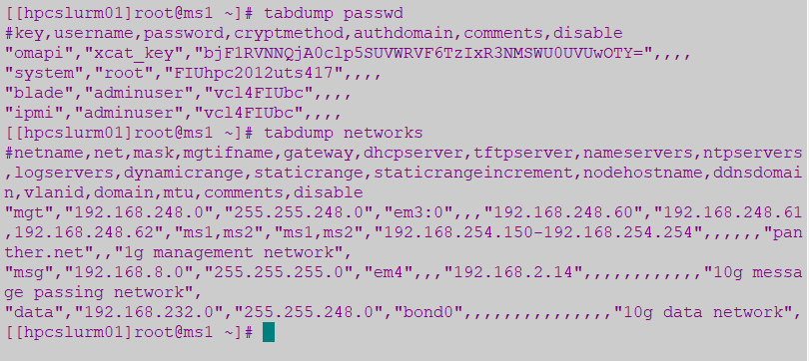
xCAT - Global Configuration

Slide 13

xCAT – Objects Definitions
Objects:
xCAT has 20 types of objects - most important are:
- Node Object: The node is the most important and used object in xCAT
- Group Object: Includes multiple node object, help handle
- Osimage Object: object represents Operating System which
multiple nodes via group. Node Inherit attributes from group
objects (rpower groupname stat vs rpower node stat)
can be deployed with xCAT (centos7.8, centos7.9)
Notes:
https://sourceforge.net/p/xcat/wiki/Listing_and_Modifying_the_Database/#database-commands-and-tables

Slide 14
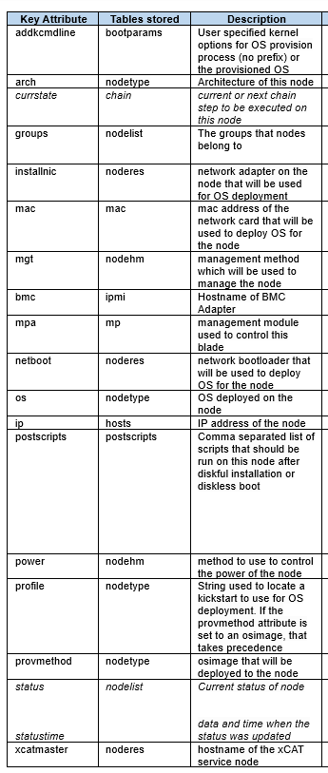
xCAT – Node Objects
Example
Object name: n132
addkcmdline=biosdevname=0 net.ifnames=0
arch=x86_64
bmc=r132
chain=runcmd=bmcsetup,osimage=alma9.5-x86_64-netboot-compute
cpucount=64
cputype=Intel(R) Xeon(R) Gold 6430
currchain=standby
currstate=netboot alma9.7-x86_64-compute
groups=alma9,hpe
hostnames=n132-ens15f1d1
installnic=mac
ip=192.168.246.202
mac=d4:04:e6:b4:8d:62|d4:04:e6:b4:8d:63!n132-ens15f1d1
memory=3096244MB
mgt=ipmi
mtm=HPE:P52499-B21
netboot=xnba
nicdevices.bond0=eth0|eth1
nicdevices.bond0.418=bond0
nicextraparams.bond0=mode=802.3ad miimon=100 ipv4.dns=192.168.246.2 ipv4.dns-search=roary.net
nichostnamesuffixes.bond0.418=-data
nicips.bond0.418=192.168.233.202
nicips.bond0=192.168.246.202
nicnetworks.bond0.418=data
nicnetworks.bond0=net427
nictypes.bond0.418=vlan
nictypes.eth0=Ethernet
nictypes.eth1=Ethernet
nictypes.bond0=bond
os=alma9.7
postbootscripts=otherpkgs
postscripts=syslog,remoteshell,syncfiles,setupntp,roary-sethostname,confignetwork,roary-repo-alma9,roary-ldap,roary-nouserlogin,roary-setuplustre,roary-slurm
profile=compute
provmethod=alma9.7-x86_64-netbootIB-compute
serial=3M1D1T10JW
status=booted
statustime=06-01-2026 14:50:29
supportedarchs=x86,x86_64
updatestatus=synced
updatestatustime=06-01-2026 14:51:59
Notes:
https://xcat-docs.readthedocs.io/en/latest/guides/admin-guides/basic_concepts/xcat_object/node.html
https://xcat-docs.readthedocs.io/en/stable/guides/admin-guides/references/man7/node.7.html

Slide 15
xCAT – Node Objects
Sample command to add a new node and set attributes values:
nodeadd n132 groups=alma9,hpe
chdef -t node n132 ip=192.168.246.202 \ mac=d4:04:e6:b4:8d:62
chdef -t node n132 netboot=xnba installnic=mac
chdef -t node n132 os=alma9.7 arch=x86_64
chdef -t node n132 addkcmdline="biosdevname=0 net.ifnames=0"
chdef -t node n132 bmc=r132 mgt=ipmi
chdef -t node n132 provmethod=alma9.7-x86_64-netbootIB-compute
chdef -t node n132 postscripts="syslog,remoteshell,syncfiles,setupntp,roary-sethostname,confignetwork,roary-repo-alma9,roary-ldap,roary-nouserlogin,roary-setuplustre,roary-slurm"

Slide 16
xCAT – Groups Objects
Compute Nodes groups currently in use:
Sample command to add a new node:
Nodes | Groups (stored on nodelist) | osimage (provmethod)
n001 | dell & 16C_128G | alma9.7-x86_64-netbootIB-compute
n003,n006-n012 | dell & 16C_128G | alma9.5-x86_64-netboot-compute
n095-n102 | alma9 & dell | alma9.5-x86_64-netboot-compute
n126-n127 | alma9 & hpe | alma9.5-x86_64-netboot-compute
n128-n133 | alma9 & hpe | alma9.7-x86_64-netbootIB-compute
gpu-a100-01..07 | raptor | alma9.5-x86_64-netboot-cudaruntime
g009 | raptor | alma9.5-x86_64-netboot-cudaruntime
login1,login2 | login,alma9,dell | alma9.5-x86_64-install-compute
dm01 | dm,alma9,dell | alma9.5-x86_64-install-compute
> nodeadd gpu-a100-01 groups=raptor,alma9
> nodeadd n126-n133 groups=alma9,hpe
Nodes | Groups (stored on nodelist)
v003 | viz & R720
Nodes | Groups
dell | Stored on noderes, nodehm tables
hpe | Stored on noderes, nodehm tables
raptor | Stored on noderes, nodehm tables
R720 | Stored on noderes, nodehm tables
Nodes | Groups
compute | Stored on nodetype table
alma9 | Stored on nodetype table
Infra Nodes | Groups
hpcslurm | slurmmn,alma9
hpcxcat | xcatmn
login1,login2 | login
dm01 | dm
l01-l03 | hpcdns
Notes:
https://xcat-docs.readthedocs.io/en/latest/guides/admin-guides/basic_concepts/xcat_object/group.html
https://xcat-docs.readthedocs.io/en/latest/guides/admin-guides/references/man7/group.7.html

Slide 17
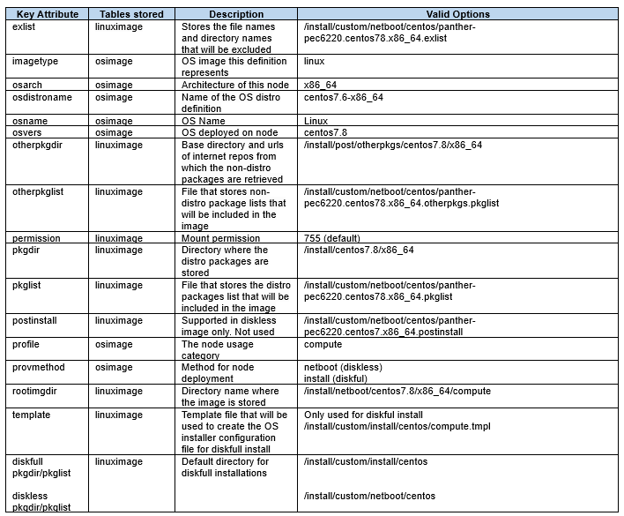
xCAT – OSimage Objects
Example 1
Object name: alma9.7-x86_64-netbootIB-compute
exlist=/opt/xcat/share/xcat/netboot/alma/compute.alma9.x86_64.exlist
imagetype=linux
kernelver=5.14.0-611.54.3.el9_7.x86_64
osarch=x86_64
osdistroname=alma9.7-x86_64
osname=Linux
osvers=alma9.7
otherpkgdir=/install/post/otherpkgs/alma9.7/x86_64
otherpkglist=/install/custom/netboot/alma/ib.alma9.7.doca.pkglist
permission=755
pkgdir=/install/alma9.7/x86_64,/install/kernels/5.14.0-611.54.3.el9_7.x86_64
pkglist=/opt/xcat/share/xcat/netboot/alma/compute.alma9.x86_64.pkglist
postinstall=/opt/xcat/share/xcat/netboot/alma/compute.alma9.x86_64.postinstall
profile=compute
provmethod=netboot
rootimgdir=/install/netboot/alma9.7/x86_64/compute-ib
11:17:21 hpcxcat /home/lenz # lsos alma9.7-x86_64-netboot-cudaruntime
Example 2
Object name: alma9.7-x86_64-netboot-cudaruntime
exlist=/opt/xcat/share/xcat/netboot/alma/compute.alma9.x86_64.exlist
imagetype=linux
kernelver=5.14.0-611.54.3.el9_7.x86_64
osarch=x86_64
osdistroname=alma9.7-x86_64
osname=Linux
osvers=alma9.7
otherpkgdir=/install/post/otherpkgs/alma9.7/x86_64
otherpkglist=/install/custom/netboot/alma/cudaruntime.alma9.7.x86_64.otherpkgs.pkglist
permission=755
pkgdir=/install/alma9.7/x86_64,/install/kernels/5.14.0-611.54.3.el9_7.x86_64
pkglist=/opt/xcat/share/xcat/netboot/alma/compute.alma9.x86_64.pkglist
postinstall=/opt/xcat/share/xcat/netboot/alma/compute.alma9.x86_64.postinstall
profile=compute
provmethod=netboot
rootimgdir=/install/netboot/alma9.7/x86_64/cudaruntime
11:17:42 hpcxcat /home/lenz # lsos alma9.7-x86_64-netboot-compute
Notes:
https://xcat-docs.readthedocs.io/en/stable/guides/admin-guides/basic_concepts/xcat_object/osimage.html
https://xcat-docs.readthedocs.io/en/latest/guides/admin-guides/references/man7/osimage.7.html

Slide 18
xCAT – OSimage Objects
OSimage definition currently used for diskless – alma9.5:
-Created:
> mkdef -t osimage -o alma9.5-x86_64-netboot-compute profile=compute imagetype=linux osarch=x86_64 osname=Linux osvers=alma9.5 permission=755 provmethod=netboot rootimgdir=/install/netboot/alma9.5/x86_64/compute pkgdir=/install/alma9.5/x86_64
-Adding package definition and directories:
> chdef -t osimage -o alma9.5-x86_64-netboot-compute exlist=/opt/xcat/share/xcat/netboot/alma/compute.alma9.x86_64.exlist otherpkgdir=/install/post/otherpkgs/alma9.5/x86_64 otherpkglist=/install/custom/netboot/alma/compute.alma9.x86_64.otherpkgs.pkglist pkglist=/opt/xcat/share/xcat/netboot/alma/compute.alma9.x86_64.pkglist postinstall=/opt/xcat/share/xcat/netboot/alma/compute.alma9.x86_64.postinstall
Command to list all osimage definitions (current & previous OS versions):
> lsdef –t osimage
See attributes of current osimage:
> lsdef –t osimage alma9.5-x86_64-netboot-compute
Assign osimage to the node to be installed:
> nodeset gpu-a100-01 osimage=alma9.5-x86_64-netboot-compute

Slide 19
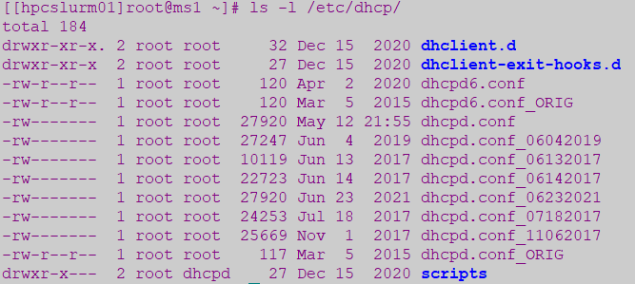
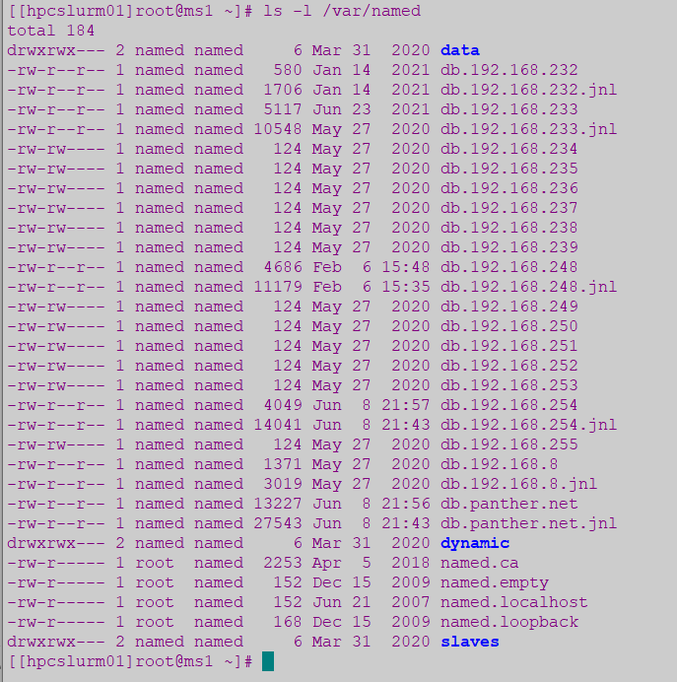
xCAT – DHCP & DNS Configuration
DHCP Service - /etc/dhcp/dhcpd.conf
> Create new dhcpd.conf file: makedhcp –n (run this once)
> Add new node to dhcp: makedhcp –a nodename
> Command to query node with DHCP: makedhcp –q gpu-a100-01
[root@hpcxcat dhcp]# makedhcp -q gpu-a100-01
gpu-a100-01: ip-address = 192.168.246.37, hardware-address = d4:04:e6:06:04:ac
DNS Service: /var/named
> Create new DNS for all the nodes: makedns –n (run this once)
> Add new node to DNS: makedns nodename
> Make host file from DNS: makehosts
> Check output in /etc/hosts file
[root@hpcxcat dhcp]# more /etc/hosts |grep gpu-a100-01
192.168.254.55 r-a100-01 r-a100-01.roary.net
192.168.246.37 gpu-a100-01 gpu-a100-01.roary.net
[root@hpcxcat dhcp]# more /etc/hosts |grep node07
192.168.233.37 gpu-a100-01 gpu-a100-01.roary.net
Notes:
https://xcat-docs.readthedocs.io/en/stable/guides/admin-guides/references/man8/makedhcp.8.html?highlight=makedhcp
https://xcat-docs.readthedocs.io/en/stable/guides/admin-guides/references/man8/makedns.8.html?highlight=makedns

Slide 20
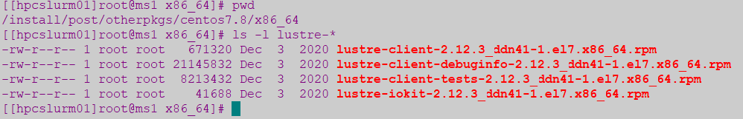
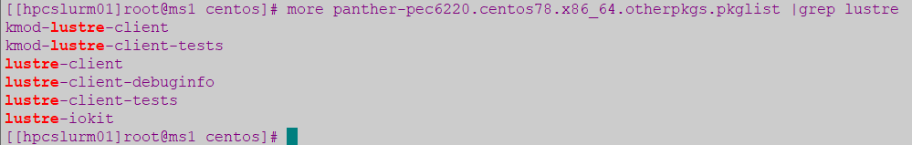
xCAT - Create repository for additional packages under /install/post/otherpkgs
Any additional packages not included on the AlmaLinux7 ISO Image can be added under a repository - /install/post/otherpkgs/alma9.5/x86_64 and it can be rebuilt as it gets updated with new RPMs
The list of additional RPM packages to install is maintained under:
/install/custom/netboot/alma/compute.alma9.x86_64.otherpkgs.pkglist
Copy all the RPMS in /install/post/otherpkgs/alma9.5/x86_64
Create initial repository - run this only once to createrepo the first time
> Createrepo /install/post/otherpkgs/alma9.5/x86_64/
Update repository - any additional rpms, use “update” with the createrepo command
> createrepo --update -v /install/post/otherpkgs/alma9.5/x86_64/
If using comps.xml (for IB Mellanox Driver)
Rebuild repo: createrepo --update -v -g comps.xml /install/post/otherpkgs/alma9.5/x86_64/
Generate new image with the new additional RPMs and pack Image for diskless install
> genimage alma9.5-x86_64-netboot-compute
> packimage alma9.5-x86_64-netboot-compute
Notes:
https://xcat-docs.readthedocs.io/en/stable/guides/admin-guides/manage_clusters/common/deployment/additionalpkg/nonubuntu_os_other_pkg.html

Slide 21
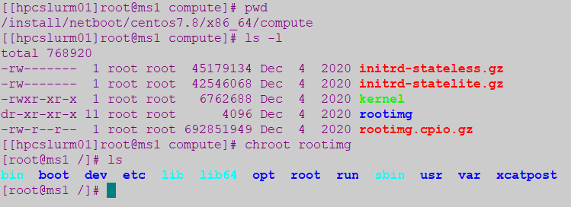
xCAT Diskless Installation (RAMdisk-based)
Create image from ISO file with copycds command under /install/alma9.5:
> copycds -n alma9.5 -a x86_64 AlmaLinux-9.5-x86_64-dvd.iso
After executing copycds, these osimage definitions are created by default:
alma9.5-x86_64-install-compute is the default osimage definition used for diskful installation
alma9.5-x86_64-netboot-compute is the default osimage definition used for diskless installation
Generate Diskless Image under /install/netboot/alma9.5/x86_64/compute
> genimage alma9.5-x86_64-netboot-compute
> Rootimg accessible can be modified before packing it with command: chroot rootimg
Pack Diskless Image from chroot FS
> packimage alma9.5-x86_64-netboot-compute
Notes:
https://xcat-docs.readthedocs.io/en/stable/guides/admin-guides/manage_clusters/ppc64le/diskless/copy_image.html
https://xcat-docs.readthedocs.io/en/stable/guides/admin-guides/manage_clusters/ppc64le/diskless/gen_image.html
https://xcat-docs.readthedocs.io/en/stable/guides/admin-guides/manage_clusters/ppc64le/diskless/customize_image/postscript_execution.html
https://sourceforge.net/p/xcat/wiki/Installing_Stateful_Linux_Nodes/
https://xcat-docs.readthedocs.io/en/latest/guides/admin-guides/references/man1/genimage.1.html?highlight=genimage
https://xcat-docs.readthedocs.io/en/latest/guides/admin-guides/references/man1/packimage.1.html?highlight=packimage

Slide 22
Preparing new compute node for xCAT provisioning
Configure DRAC/ILO on the new node:
-Assign an IP address from the DRAC/ILO MGMT VLAN 421: 192.168.254.xx
-Configure DRAC/ILO network interface with this IP and take note of the MAC address
-Enable IPMI over LAN (as Administrator)
-Create and enable user as Administrator: “adminuser” and match password defined in xCAT passwd table for the IPMI user
Capture all Network interfaces to be used and their MAC addresses from DRAC/ILO GUI:
This includes at least 2 set of MACs in addition to the DRAC interface which will be assigned for:
-MGMT VLAN 421: 192.168.246.xx
-Data VLAN 418: 192.168.233.xx
Assign IP addresses for each of this network interfaces
Assign free IPs for the 3 interfaces in the :
-DRAC/ILO interface MGMT VLAN 421: 192.168.254.xx
-MGMT VLAN 421: 192.168.246.xx
-Data VLAN 418: 192.168.233.xx
Update information in the Excel sheet (fiu_hpc_detailsv10) on OneDrive
Define the new node names with IPs assigned to be added in xCAT for host and DNS Configuration:
Follow this naming convention:
-DRAC/ILO interface used for BMC: rxxx – like r126, r-a100-01, rv003
-MGMT Interface: nxxx or gxxx or vxxx – like n125, gpu-a100-01, v003
-Data Interface: hpcnodexxx – like n126, gpu-a100-01, v003

Slide 23
Adding new compute node/group definitions in xCAT
Add new node to xCAT node/group object definitions:
nodeadd gpu-a100-01 groups=raptor,alma9
nodeadd gpu-a100-01 groups=raptor | nodeadd n126 groups=dell | nodeadd v003 groups=viz
nodeadd r-a100-01 groups=mgt | nodeadd r126 groups=mgmt | nodeadd rv003 groups=vizmgt
Add additional node attributes:
chdef –t node gpu-a100-01 mac=d4:04:e6:06:04:ac ip=192.168.246.37
chdef –t node gpu-a100-01 ip=192.168.233.37
chdef –t node r-a100-01 ip=192.168.254.55
chdef -t node gpu-a100-01 netboot=xnba installnic=d4:04:e6:06:04:ac
chdef -t node gpu-a100-01 os=alma9.5 arch=x86_64
chdef -t node gpu-a100-01 addkcmdline=“ifname=em3:F8:BC:12:20:16:00”
chdef -t node raptor postscripts=“roary-primary-nic,roary-othernics-alma9,roary-ldap,roary-nouserlogin,roary-resolv-alma9,roary-yumrepo-alma9,roary-rpms-alma9,roary-setuplustre,roary-mlnx-ofed,roary-gpucuda,roary-slurm-alma9-current”
Nodes | Groups (stored on nodelist)
n001 | dell & 16C_128G
n003,n006-n012 | dell & 16C_128G
n095-n102 | alma9 & dell
n126-n127 | alma9 & hpe
n128-n133 | alma9 & hpe
gpu-a100-01..07 | raptor
g009 | raptor
login1,login2 | login,alma9,dell
dm01 | dm,alma9,dell

Slide 24
Update DHCP & DNS with new compute node
Add new node to dhcp:
makedhcp –a gpu-a100-01 | makedhcp –a r-a100-01 | makedhcp –a gpu-a100-01
makedhcp –a n125 | makedhcp –a n126 | makedhcp –a r126
To Query:
makedhcp –q gpu-a100-01
Add new node to DNS to update /etc/hosts file:
makedns –a gpu-a100-01
makedns –a r-a100-01
makedns –a gpu-a100-01
makehosts

Slide 25
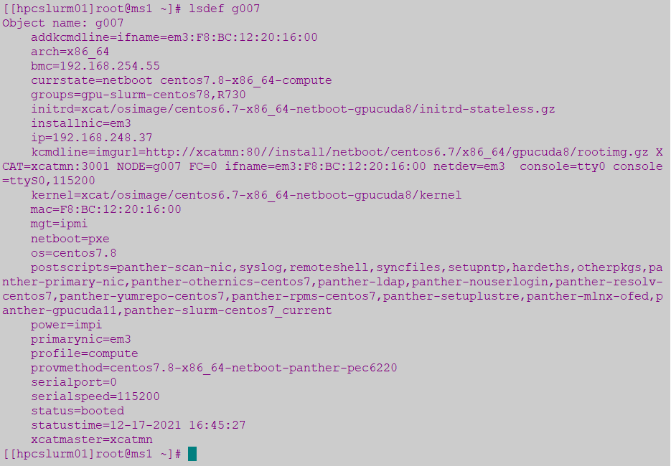
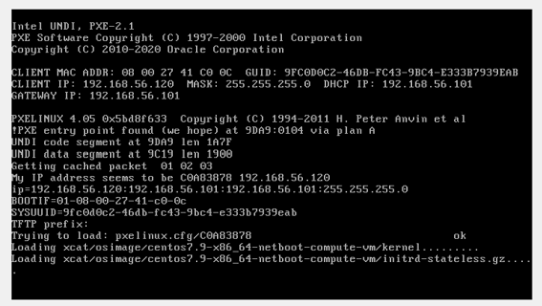
Set the boot state for the node/noderange
List current definition command:
lsdef gpu-a100-01
Set the boot state for the node with nodeset command:
nodeset gpu-a100-01 osimage= alma9.5-x86_64-netboot-compute
rpower gpu-a100-01 stat
rpower gpu-a100-01 reset
Note:
nodeset for pxe makes changes to /tftpboot/pxelinux.cfg/{node hex ip}
Notes:
https://xcat-docs.readthedocs.io/en/latest/guides/admin-guides/references/man8/nodeset.8.html
https://xcat-docs.readthedocs.io/en/latest/guides/admin-guides/references/man1/rpower.1.html?highlight=rpower
https://xcat-docs.readthedocs.io/en/latest/guides/admin-guides/references/man8/rinstall.8.html?highlight=rinstall
https://xcat-docs.readthedocs.io/en/stable/guides/admin-guides/references/man1/xdsh.1.html
https://xcat-docs.readthedocs.io/en/stable/guides/admin-guides/manage_clusters/ppc64le/parallel_cmd.html

Slide 26
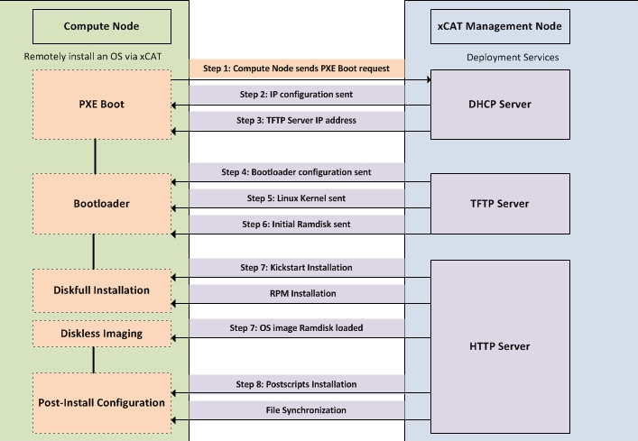
xCAT Node Installation Process

Slide 27
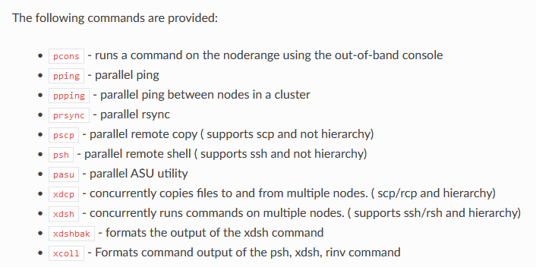
Parallel Commands from xCAT Management node
xCAT provides a set of commands that can run common remote commands
xdsh - Concurrently runs remote commands on multiple nodes:
xdsh n095-n102 umount -t lustre /home /scratch
xdsh n001 “df –h”
Notes:
https://xcat-docs.readthedocs.io/en/latest/guides/admin-guides/references/man8/nodeset.8.html
https://xcat-docs.readthedocs.io/en/latest/guides/admin-guides/references/man1/rpower.1.html?highlight=rpower
https://xcat-docs.readthedocs.io/en/latest/guides/admin-guides/references/man8/rinstall.8.html?highlight=rinstall
https://xcat-docs.readthedocs.io/en/stable/guides/admin-guides/references/man1/xdsh.1.html
https://xcat-docs.readthedocs.io/en/stable/guides/admin-guides/manage_clusters/ppc64le/parallel_cmd.html

Slide 28
xCAT – Backup/Restore xCAT DB Tables
Backup:
dumpxCATdb: Dump all xCAT db tables to CSV files under specified directory (often used for xCAT reinstallation or migration)
Daily cron job to backup DB tables (7 days kept in /home/share/scripts/xCAT/compressed)
## Backup xCAT Database on ms1 - Daily ##
0 4 * * * /home/share/scripts/xCAT/xCATdump.sh
To dump the xCAT database into backup directory, including the auditlog and eventlog enter:
dumpxCATdb -a -p /home/share/scripts/xCAT/ms1-dump-yy-dd-mm
Restore:
-restorexCATdb: Restore all xCAT db tables from CSV files under specified directory
-To restore the xCAT database from backup directory, including the auditlog and eventlog enter:
restorexCATdb -a -p /home/share/scripts/xCAT/hpcxcat-dump-yy-dd-mm
Notes:
https://xcat-docs.readthedocs.io/en/stable/guides/admin-guides/references/man1/dumpxCATdb.1.html
https://xcat-docs.readthedocs.io/en/stable/guides/admin-guides/references/man1/restorexCATdb.1.html

Slide 29
Cleanup retired Nodes on xCAT
Keep a backups of xCAT DB and DHCP/DNS configuration before removing entries
> dumpxCATdb -a -p "/home/share/scripts/xCAT/hpcxcat-dump_mmddyy
> cp –pr /etc/dhcp/dhcpd.conf /etc/dhcp/dhcpd.conf_mmddyy
> cp –pr /etc/hosts /etc/hosts_mmddyy
> cp –pr /var/lib/dhcpd/dhcpd.leases /var/lib/dhcpd/dhcpd.lease_mmddyy
Remove nodes from DNS
> makedns –d nodename
> makehosts (to update /etc/hosts file)
> Restart “named” services if entries not removed from DNS
Remove nodes from DHCP
> makedhcp –d nodename
Remove nodes from xCAT
> rmdef –t node nodename

Slide 30
Additional Material about xCAT
xCAT Guide:
https://xcat-docs.readthedocs.io/en/stable/index.html
https://xcat-docs.readthedocs.io/en/latest/guides/admin-guides/basic_concepts/xcat_db/index.html
https://xcat-docs.readthedocs.io/en/latest/guides/admin-guides/basic_concepts/xcat_object/index.html
https://sourceforge.net/p/xcat/wiki/Listing_and_Modifying_the_Database/#node-group-support-in-the-xcat-tables
https://sourceforge.net/p/xcat/wiki/Listing_and_Modifying_the_Database/#database-commands-and-tables
https://xcat-docs.readthedocs.io/en/latest/guides/admin-guides/basic_concepts/xcat_object/node.html
https://xcat-docs.readthedocs.io/en/stable/guides/admin-guides/references/man7/node.7.html
https://xcat-docs.readthedocs.io/en/latest/guides/admin-guides/basic_concepts/xcat_object/group.html
https://xcat-docs.readthedocs.io/en/latest/guides/admin-guides/references/man7/group.7.html
https://xcat-docs.readthedocs.io/en/stable/guides/admin-guides/basic_concepts/xcat_object/osimage.html
https://xcat-docs.readthedocs.io/en/latest/guides/admin-guides/references/man7/osimage.7.html
https://xcat-docs.readthedocs.io/en/stable/guides/admin-guides/references/man8/makedhcp.8.html?highlight=makedhcp
https://xcat-docs.readthedocs.io/en/stable/guides/admin-guides/references/man8/makedns.8.html?highlight=makedns
https://xcat-docs.readthedocs.io/en/stable/guides/admin-guides/manage_clusters/ppc64le/diskless/copy_image.html
https://xcat-docs.readthedocs.io/en/stable/guides/admin-guides/manage_clusters/ppc64le/diskless/gen_image.html
https://xcat-docs.readthedocs.io/en/stable/guides/admin-guides/manage_clusters/ppc64le/diskless/customize_image/postscript_execution.html
https://xcat-docs.readthedocs.io/en/latest/guides/admin-guides/references/man1/genimage.1.html?highlight=genimage
https://xcat-docs.readthedocs.io/en/latest/guides/admin-guides/references/man1/packimage.1.html?highlight=packimage
https://xcat-docs.readthedocs.io/en/latest/guides/admin-guides/references/man8/nodeset.8.html
https://xcat-docs.readthedocs.io/en/latest/guides/admin-guides/references/man1/rpower.1.html?highlight=rpower
https://xcat-docs.readthedocs.io/en/stable/guides/admin-guides/references/man1/dumpxCATdb.1.html
https://xcat-docs.readthedocs.io/en/stable/guides/admin-guides/references/man1/restorexCATdb.1.html

Slide 31


Questions & Answers

